Slide 1
BUSINESS EVOLUTION EMPOWERING PEOPLE
Webinar:
Mental Toughness
The Key to performance,
wellbeing & positive behaviour
Friday, 24th of April, between 14:30-15:30
ORGANIZATOR
CO-ORGANIZATOR

Slide 2
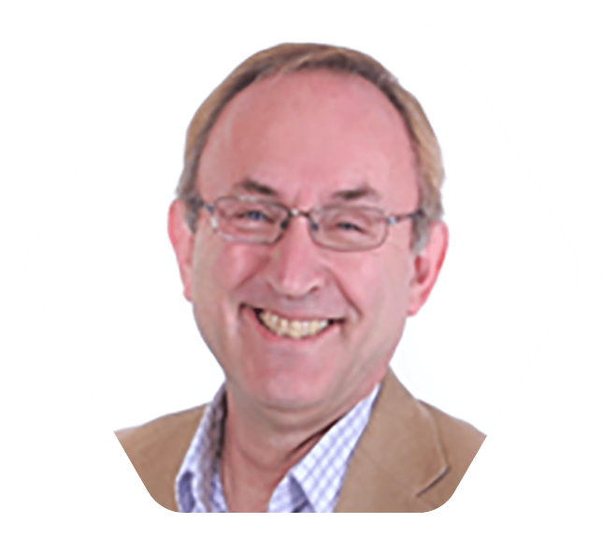
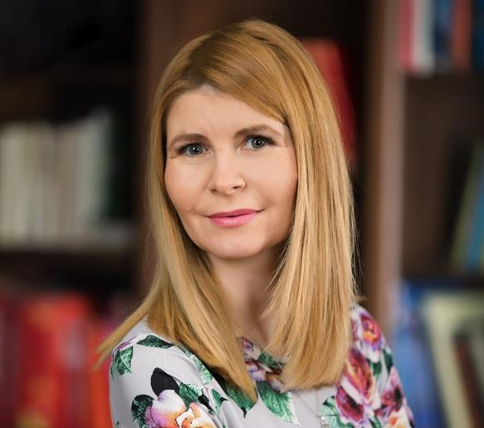
BUSINESS EVOLUTION EMPOWERING PEOPLE
ORGANIZATOR:
Webinar: Mental Toughness
The Key to performance,
wellbeing & positive behaviour
CO-ORGANIZATOR:

Slide 3
Essentially its about being the best that you can be.
“A personality trait which determines in large part how people deal with challenge, stressors, opportunity and pressure.. irrespective of prevailing circumstances”
Research shows a close correlation with:
Performance
Agility
Wellbeing
Aspirations - ambitious
It has major applications in coaching activity, explaining why we behave the way we do when confronted by events.

Slide 4
Mental Toughness – a personality trait
Most personality traits describe and help you assess “how you act when things happen”. They describe BEHAVIOUR.
Mental Toughness describes and assesses “how you think when something happens”. Your MENTAL responses.
This help us understand “WHY you act when something happens”.

Slide 5
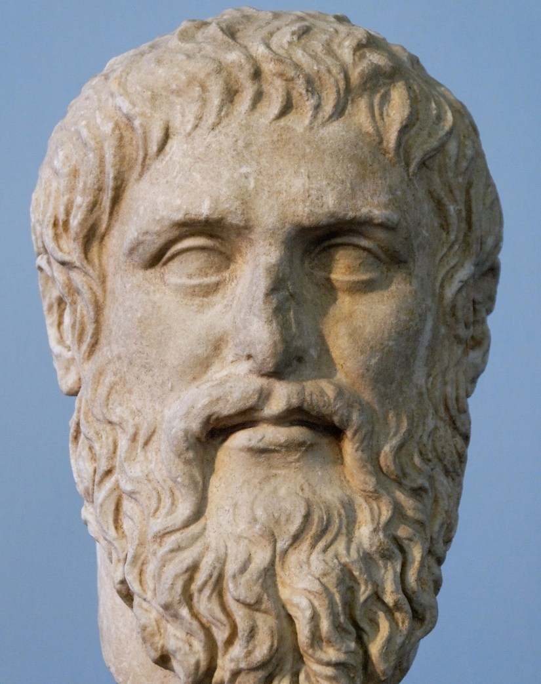
Origins - Philosophy
The concept MENTAL TOUGHNESS is long understood
Plato (c 400 BC) – 4 cardinal virtues - wisdom, temperance, fortitude and justice
Fortitude – “having emotional power and the ability to withstand adversity” - well-being (eudaimonia) is the highest aim of (moral) thought and conduct
Draws the distinction between happiness/hedonism and contentment
Wisdom – comes from self awareness – again relevant
Notes:
Philosopher Nicholas Maxwell defines wisdom as “the capacity, the desire, and the active endeavour to realize what is of value in life, for oneself and others.” Prudence is a close synonym of wisdom.
Wisdom in this context represents self-awareness - about how one responds to the world around them – and reflection – what does this mean for me and for others.
This sits happily with the concept of Mental Toughness or, as Plato described it, Fortitude.

Slide 6
Origins – Academic – mid 1950s +
One root - HEALTH PSYCHOLOGY:
Resilience - Commitment, Control – a passive concept
Hardiness (Kobasa) – Commitment, Control + Challenge
The other root came from practitioners in people development and sports coaching: Jim Loehr & Dienstbier
Psychology – Prof Peter Clough – added Confidence to create the 4Cs concept. Now developed into 8 factors.
Notes:
Karasek's (1979) job demands-control model of occupational stress provides a work context for demands and autonomy. Kasarek showed that the more an individual felt they had control over their life and their circumstances, the less likely they were to be stressed.

Slide 7
Key themes – before we move on
Mental Toughness is not “good” and Mental Sensitivity is not “bad” – without self-awareness there are issues for everyone.
1
Self-awareness and reflection are key – we all have strengths and weaknesses – if we know these, we can optimise.
2
Culture is important. Mentally Tough people can help and influence everyone else to be the best that they can be.
3
It is possible to look at the Mental Toughness profile of groups – and make a difference.
4

Slide 8
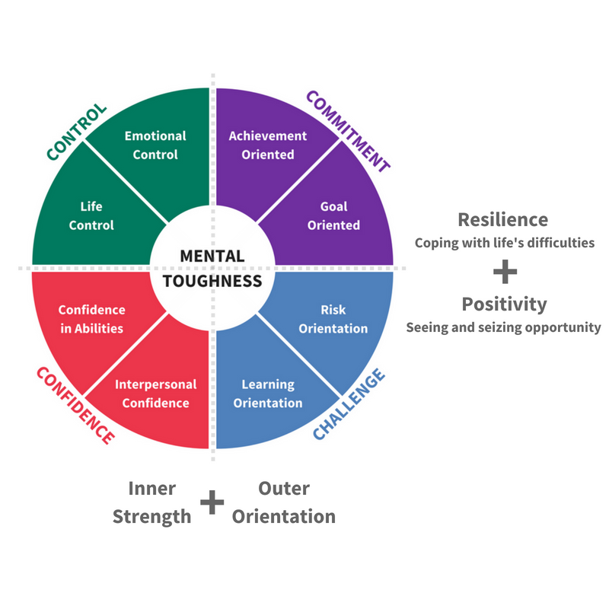
The 4Cs and the 8 Factors

Slide 9
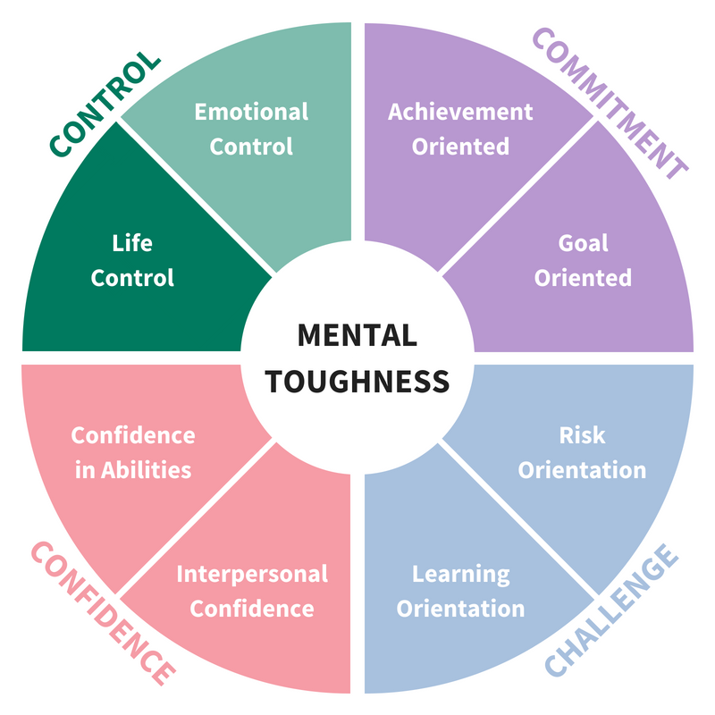
Control - Life Control
“I really believe I can do it”
Believe they make a difference.
Happily multi-task.
Good at planning & organisation.
Work hard. Everything is possible.
I might not understand it but I can master it.

Slide 10
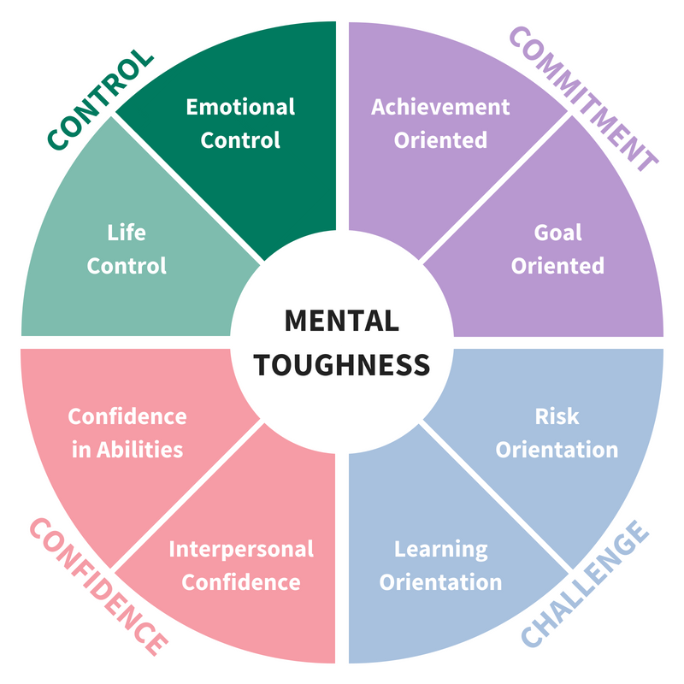
Control - Emotional Control
“I can manage my and other’s emotions”
Manage their own emotional responses.
Influence the emotional response of others.
Are difficult to provoke or annoy.
Deal well with difficult people & bullies.
Mask anxiety – maintain poise.

Slide 11
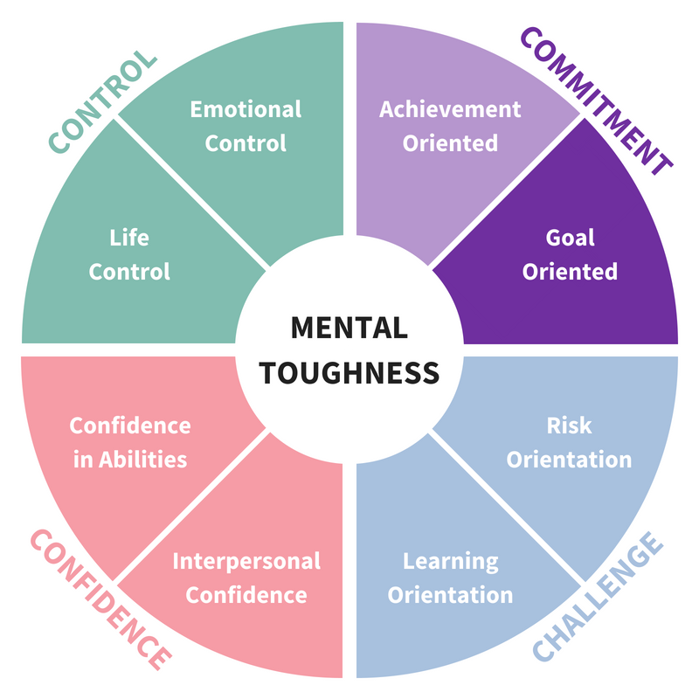
Commitment – Goal Orientation
“I promise to do it – I like working to goals”
Like working to goals and targets.
Targets motivate them – a source of drive.
Set personal bests and seek to better them.
Visualise success and feel it.
Like being tested.

Slide 12
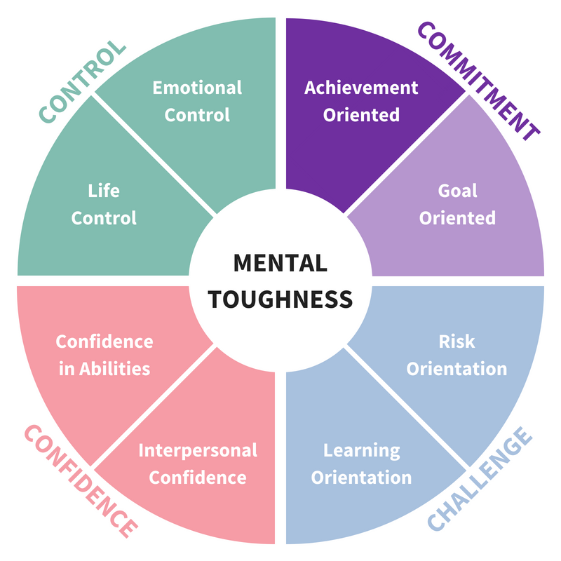
Commitment – Achievement Orientation
“I’ll do what it takes”
Will work hard even if they didn’t set the goals.
Will keep promises – to selves and others.
Conscientious.
Focus and concentrate.
Will self sacrifice to get there.

Slide 13
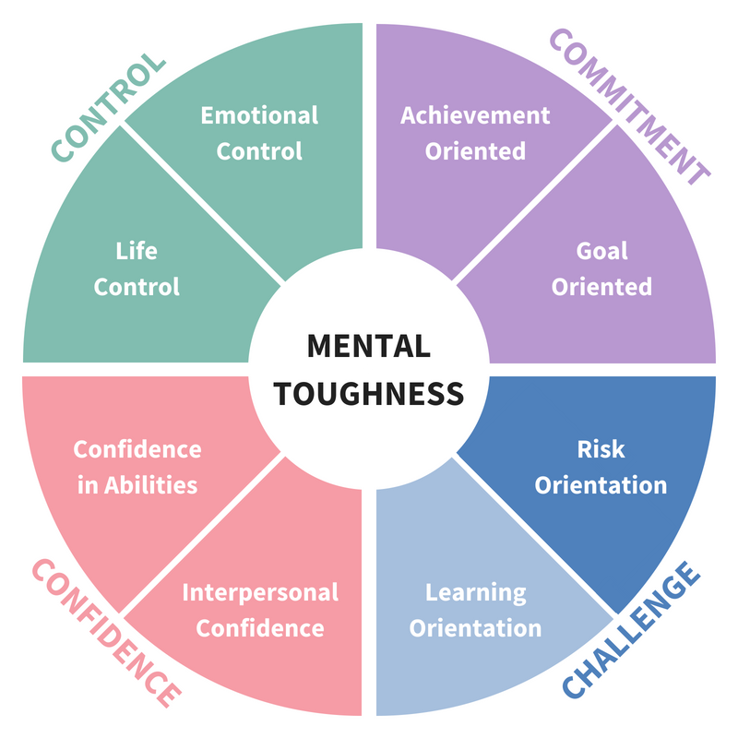
Challenge – Risk Orientation
“I will push myself – I am driven to succeed”
Will stretch themselves.
Like trying new things.
Not afraid of change – they embrace it.
Readily volunteer for new activities.
Seek out challenging opportunities – opt for the difficult over the easy.
Try anything once

Slide 14
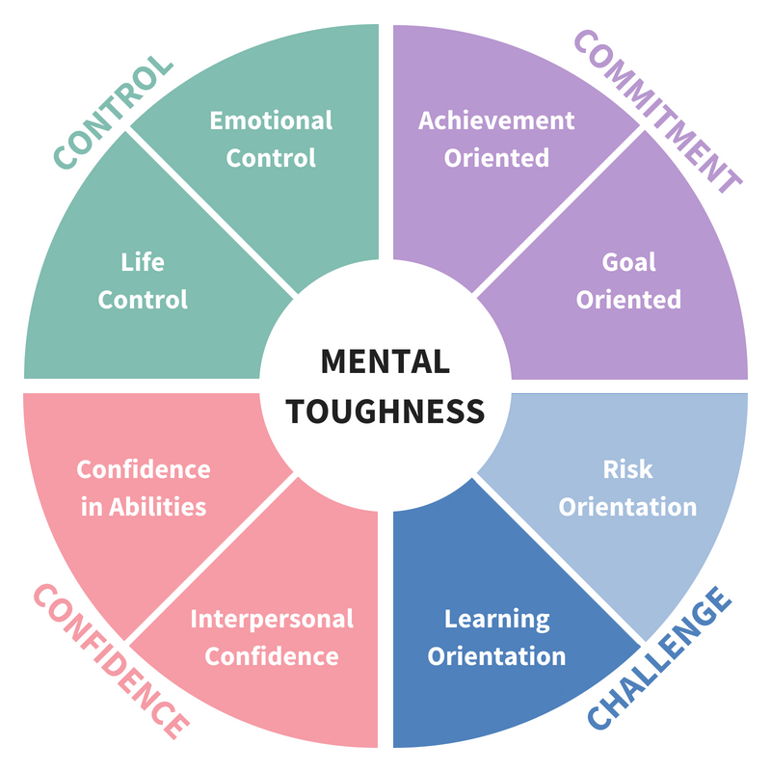
Challenge – Learning Orientation
“Even setbacks are opportunities for learning”
See setbacks as opportunities for learning.
Enjoy learning new things – reflective.
Have an optimistic view.
Aspirational.
Curious – why did it (not) work?

Slide 15
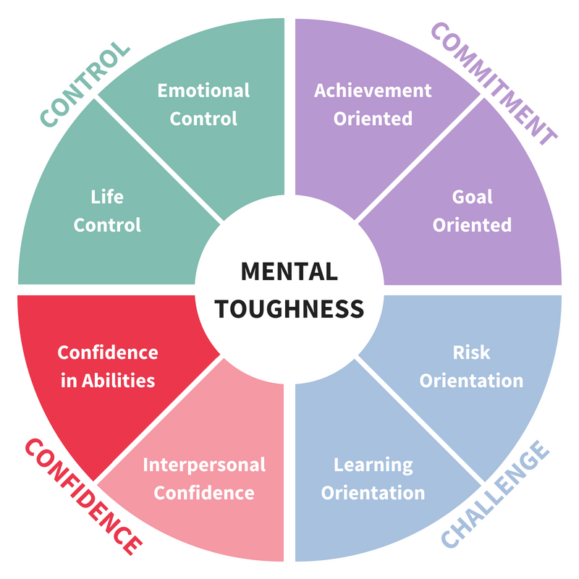
Confidence – Confidence in Abilities
“I believe I have the ability to do it”
Don't need others to tell them they can do it or to encourage them.
Have that inner belief in their abilities.
Will use their abilities.
Believe they can acquire new abilities

Slide 16
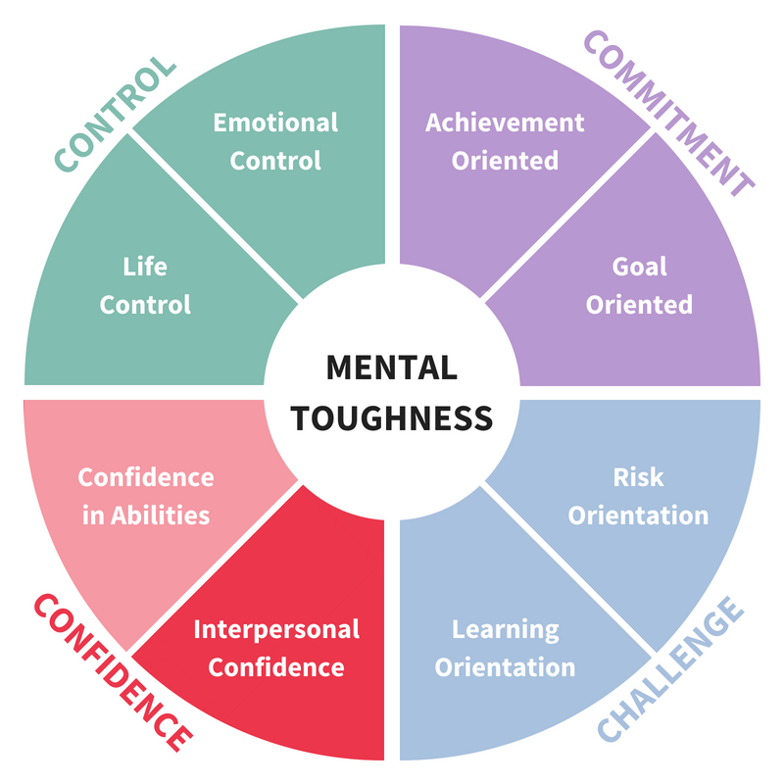
Confidence – Interpersonal Confidence
“I can influence others as much as they do me”
Will ask questions to check understanding.
Wont allow others to orally dominate.
Will provide a full response to questions.
Will show their abilities.
Will argue their corner.

Slide 17
Some important points
The opposite of Mental Toughness is Mental Sensitivity… not Mental Weakness.
There are strengths and weaknesses at both ends of the scale.
True: Mentally Tough people, in general, achieve more than Mentally Sensitive people.
Mentally Sensitive people find it harder to deal with problems and issues.
Also True: Mentally Sensitive people can achieve and lead effective lives.
Also True: We can develop the capability of Mentally Sensitive people.
What is important is Self Awareness, Reflection and Purposeful Practice.

Slide 18
BUSINESS EVOLUTION EMPOWERING PEOPLE
How can we optimise the performance of our teams?
ORGANIZATOR:
CO-ORGANIZATOR:

Slide 19
The Benefits of Mental Toughness
Helps to understand something about people and organisations/groups which is fundamental to their performance and well-being. We can answer the “why …. ?” question.
It help to explain the link between culture and the individual
Ability to evaluate – reliably – what you are doing. Enables the “holy grail” of development – true evidence-based practice.
It is an enabler – which translates into personal success and greater impact as well as organisational success.

Slide 20
BUSINESS EVOLUTION EMPOWERING PEOPLE
How do we hire the right people?
ORGANIZATOR:
CO-ORGANIZATOR:

Slide 21
BUSINESS EVOLUTION EMPOWERING PEOPLE
What analyses the MTQ Plus and how can be used at organizational and individual level?
ORGANIZATOR:
CO-ORGANIZATOR:

Slide 22
Assessing Mental Toughness

Slide 23
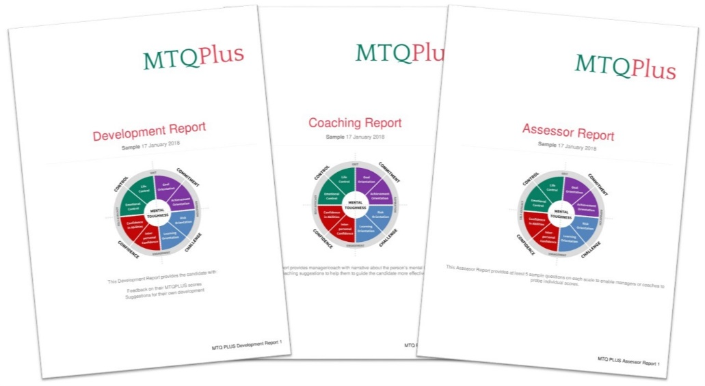
Can we assess Mental Toughness?
MTQPlus, MTQ48 and MTQ4Cs
Valid and reliable
Normative
Easy and fast to administer
Range of reports
Capability to measure difference
Notes:
So as I mentioned, we can measure mental toughness. There are a family of measure available to assess the concept but today we will focus on the MTQ48.
The MTQ48 was created by Professor Peter Clough who is a well established and credible psychometrician.
The MTQ48 is a reliable, valid and normative measure. This means that we can be confident that it is assessing what it is intended to.
The assessment can be used to measure individuals and focus on development on a individual level or it can be done for groups.
The assessment produces three reports. A development report which is designed for the candidate. It contains an explanation of the results as well as development suggestions. We also have the coaching report which also includes the same information but also contains a list of coaching suggestions and questions which can be used to support and prompt a discussion with the candidate. The third report is the assessor report. This is used for recruitment situations. The report contains an explanation of results as well as a list of suggested interview questions.
The assessment is useful for development and for research and evaluation.
When used as part of a programme, it can allow you to assess and evidence the impact – which can be useful for ofsted.

Slide 24
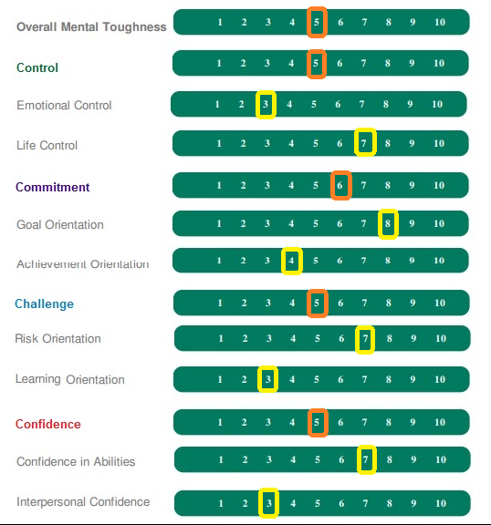
Digging deeper - MTQPlus
The overall score and the 4Cs scores might suggest that this individual is about the “norm”.
In fact there is a great deal of detail there which points to where development can take place.

Slide 25
Validity & Reliability
Reliability
Validity
MTQPLUS cfi* Cr α
Life Control | .942 | .79
Emotional Control | .896 | .76
Goal Orientation | .934 | .66
Achievement Orientation | .872* | .82
Risk Orientation | .915 | .85
Learning Orientation | .942 | .75
Confidence in Abilities | .816* | .78
Interpersonal Confidence | .938 | .74
MTQ48 Cronbach α
Overall Mental Toughness | 0.90
Control | 0.73
Commitment | 0.71
Challenge | 0.71
Confidence | 0.80
MTQ48
All scales score between 0.30 and 0.42. Generally regarded as high.
*The comparative fit index. This is not strictly an estimate of reliability but a measure of model fit – so it is more about validity. This is derived from factor analysis or structural equation modelling.

Slide 26
Developing Mental Toughness
Adding to the coaches armoury

Slide 27
Mental Toughness Development
Learning, Reflection and Practice
Learning. Almost all of the interventions are experiential. Difficult to teach someone to be more mentally tough. Need to provide the opportunity to experience an approach or a tool or a technique and then reflect on that experience.
Reflection is the important part. We are rarely always mentally tough or mentally sensitive.
Purposeful Practice. Practice until the new approach is embedded

Slide 28
Mental Toughness Development
Positive thinking – Affirmations, Thought Stopping, Self Talk, etc
Visualisation – Guided Imaging, etc
Anxiety Control – Controlled Breathing, Relaxation, Distraction, etc
Attentional Control – Dealing with Interruptions, Attention Span, etc
Goal Setting – SMART Goals, “Eating the Elephant”, Balancing Goals, etc
The test itself – reflection and good feedback
Most techniques are known to coaches and trainers. MT helps us to direct them more precisely.

Slide 29
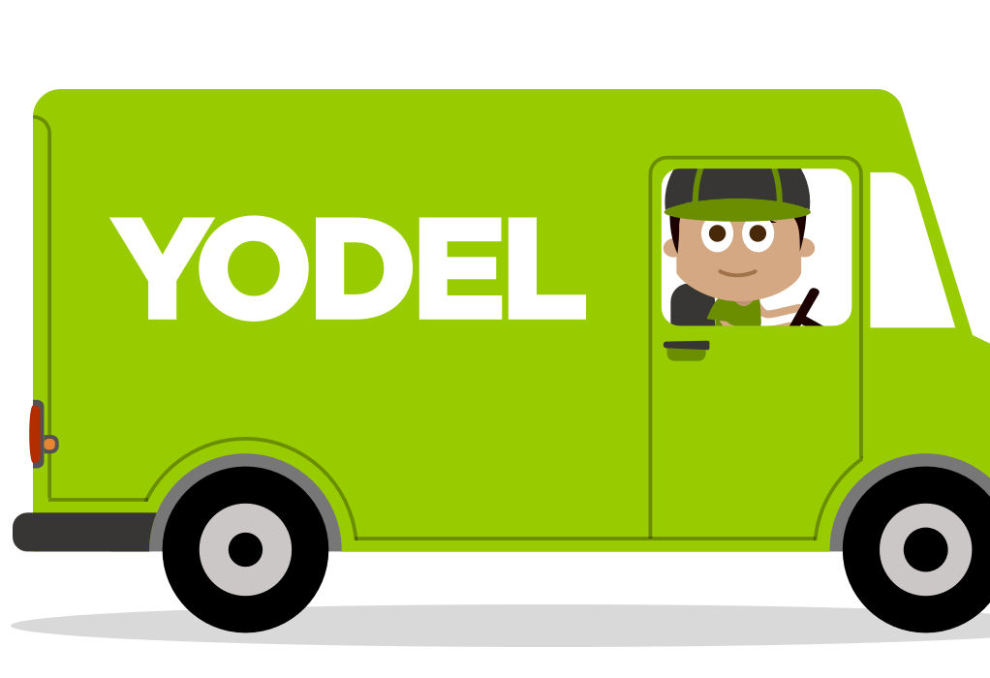
A case study
Yodel - Lynne Graham – HR Director
Can being trained in coaching skills make you a more resilient leader?
Developing a coaching culture. Trained senior managers in coaching skills – noticed a difference in behaviour in coaches
Used MTQPlus to assess before, after and after 4 months
Used a control group
Found:
Coach Group scores change in 3 key areas
Control Group – no significant change

Slide 30
What emerged
SCALE | Avg Sten score before the coaching intervention | Avg Sten score 4 months after the coaching intervention | Difference in Avg Sten score
MENTAL TOUGHNESS | 6.46 | 6.67 | +0.21
CONTROL | 6.33 | 6.54 | +0.21
Emotional Control | 5.92 | 6.25 | +0.33
Life Control | 6.63 | 6.50 | -0.13
COMMITMENT | 6.21 | 6.04 | -0.17
Goal Orientation | 6.46 | 6.50 | +0.04
Achievement Orientation | 5.96 | 5.88 | -0.12
CHALLENGE | 6.21 | 6.42 | +0.21
Risk Orientation | 6.46 | 6.54 | +0.08
Learning Orientation | 5.75 | 5.88 | +0.12
CONFIDENCE | 6.46 | 6.67 | +0.21
Confidence in Abilities | 5.83 | 5.96 | +0.13
Interpersonal Confidence | 7.00 | 7.17 | +0.17
Confirmed through qualitative studies.
Indicates that coaching skills training benefits the coach and the coachee.
Dissertation for a MSc in Coaching and Behaviour Change at Henley Management College. Awarded a distinction.

Slide 31
Another Case Study
Variable | Before - 2102 |  |  | After - 2014 | Difference*
Mental Toughness
Challenge | 5.25 |  |  | 6.16 | Significant
Commitment | 6.47 |  |  | 7.19 | Significant
Control | 5.60 |  |  | 6.54 | Significant
Life control | 6.09 |  |  | 7.20 | Significant
Emotional control | 4.91 |  |  | 5.40 | Significant – still an area for attention
Confidence | 5.49 |  |  | 6.58 | Significant
Confidence in abilities | 5.53 |  |  | 6.46 | Significant
Interpersonal confidence | 5.03 |  |  | 5.90 | Significant
Overall mental toughness | 5.94 |  |  | 6.99 | Significant
Correlated with :
Improved morale
Attainment.
Teaching Leaders – 2 year programme to develop c 200 prospective School Leaders. Each was assigned a coach as well as attending specific events.

Slide 32
BUSINESS EVOLUTION EMPOWERING PEOPLE
Mental Toughness
The Key to performance,
wellbeing & positive behaviour
ORGANIZATOR
CO-ORGANIZATOR

